Slide 1
Brain Force
An EEG-Based Brain-Computer Interface
By Alexander Johnson, Brendan Shortall, Dayanna De La Torres, Jonathan Mikalov, Mitchell Gilmore
Team 04

Slide 2
Problem Statement:
Invasive brain-computer interface devices are costly and come with a wide array of risks and medical procedures.
Disabled users may have difficulty operating a computer physically.
Brain Force will help a wide variety of disabled individuals navigate a computer by reading neural activity related to thoughts of motion and translating these thoughts into distinct commands on a computer.

Slide 3
Deliverables and Requirements:
01
Comfortable, easily removable, dry EEG sensors.
Lightweight, feasible to wear for long periods of time.
Structural integrity will hold over multiple uses.
3D Printed Headset
02
Biosampling, Filters.
12+ Channels
USB Connectivity
EEG Sampling Board
03
LSTM Neural Network
4+ classifiable states
60+% accuracy
Machine Learning Model
04
Translate ML output into distinct actions.
Small tasks for users to complete.
Make a scoreboard for ECE day competition.
Virtual 3D Environment

Slide 4
System Diagram
Headset Design and Fabrication
Circuit Board Design and Fabrication
Machine Learning Model
Virtual Environment
3D printed headset skeleton (V1 & V2).
Open source PCB schematics. BOM created.
Further signal processing.
Blender® to create environment.
Electrode housing, Electrodes with dry contact points.
Anti-aliasing low pass filters, biosignal sampling, wireless capability?
Data collection (online databases & from device). Partition into training and test.
Get output from LSTM, convert to object movement using Panda3D.
Wiring, Mount circuit board.
Redesign circuit board, get rid of unnecessary components.
Long Short-Term memory neural network.
If time permitting, explore possibilities of what we can control. (RC car, Drone, cursor)

Slide 5
Headset Design and Fabrication:
Completed:
In Progress:
Future Plans:
Found open source headset designs
Printed Version 1.0, Decided to go with different design due to structural integrity concerns.
Currently printing Version 2.0
Finding vendors for remaining hardware necessary to construct the headset
Test that the new design stays within our constraints.
Decide if changes are necessary, if so make them.
OpenBCI GitHub
3D Printer and Filament obtained from Prof. Osama
Slicing software installed and tested.
Updated OpenBCI headset,
Much more documentation surrounding construction.
Minimal expenses for obtaining remaining hardware
Measure weight, make sure that structural integrity will hold over multiple uses.
Comfortability
Decide which size will work best (SM, MED or LG)

Slide 6
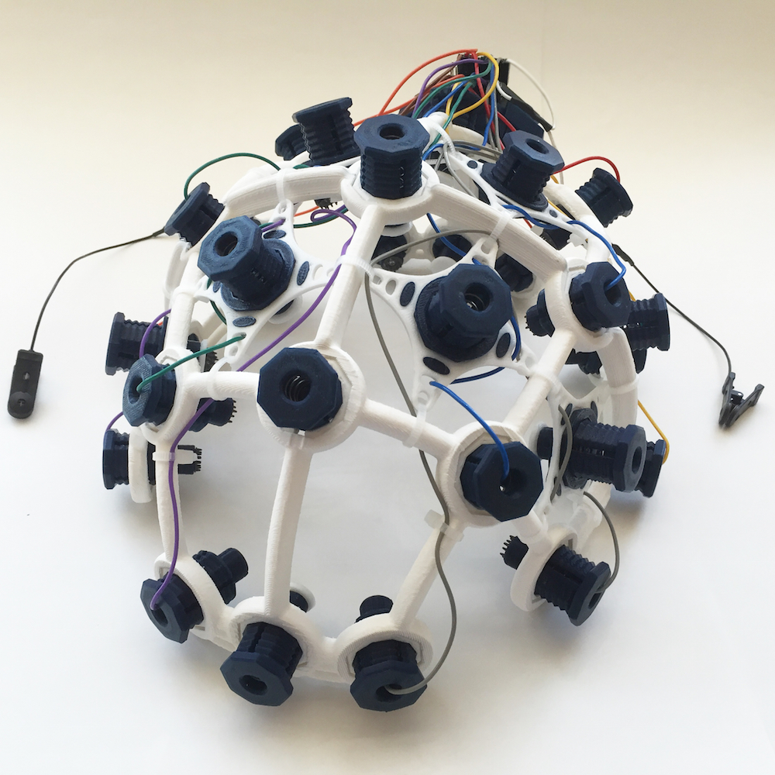
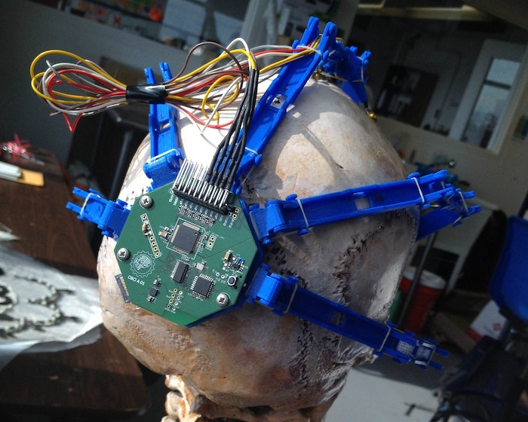

Slide 7
Circuit Board Design and Fabrication
Completed:
In Progress:
Future Plans:
Redesign PCB, remove unnecessary components.
Find a permanent solution to device/computer interface.
Add firmware to microcontroller
PCBs Printed
BOM Created
Significant components ordered
Order remaining components
Address bluetooth module issue
OpenBCI Hardware Files
Sampling Unit ordered and received
Remaining components are parted out.
Soldering station acquired
Vendors and parts list obtained, ready to send out an order.
Brainstorming ideas to deal with bluetooth module
TOP PRIORITY
Remove accelerometer, SD card reader, and RFDuino module.
Talk with BU faculty to review our board design.
Open source firmware code on OpenBCI GitHub.

Slide 8
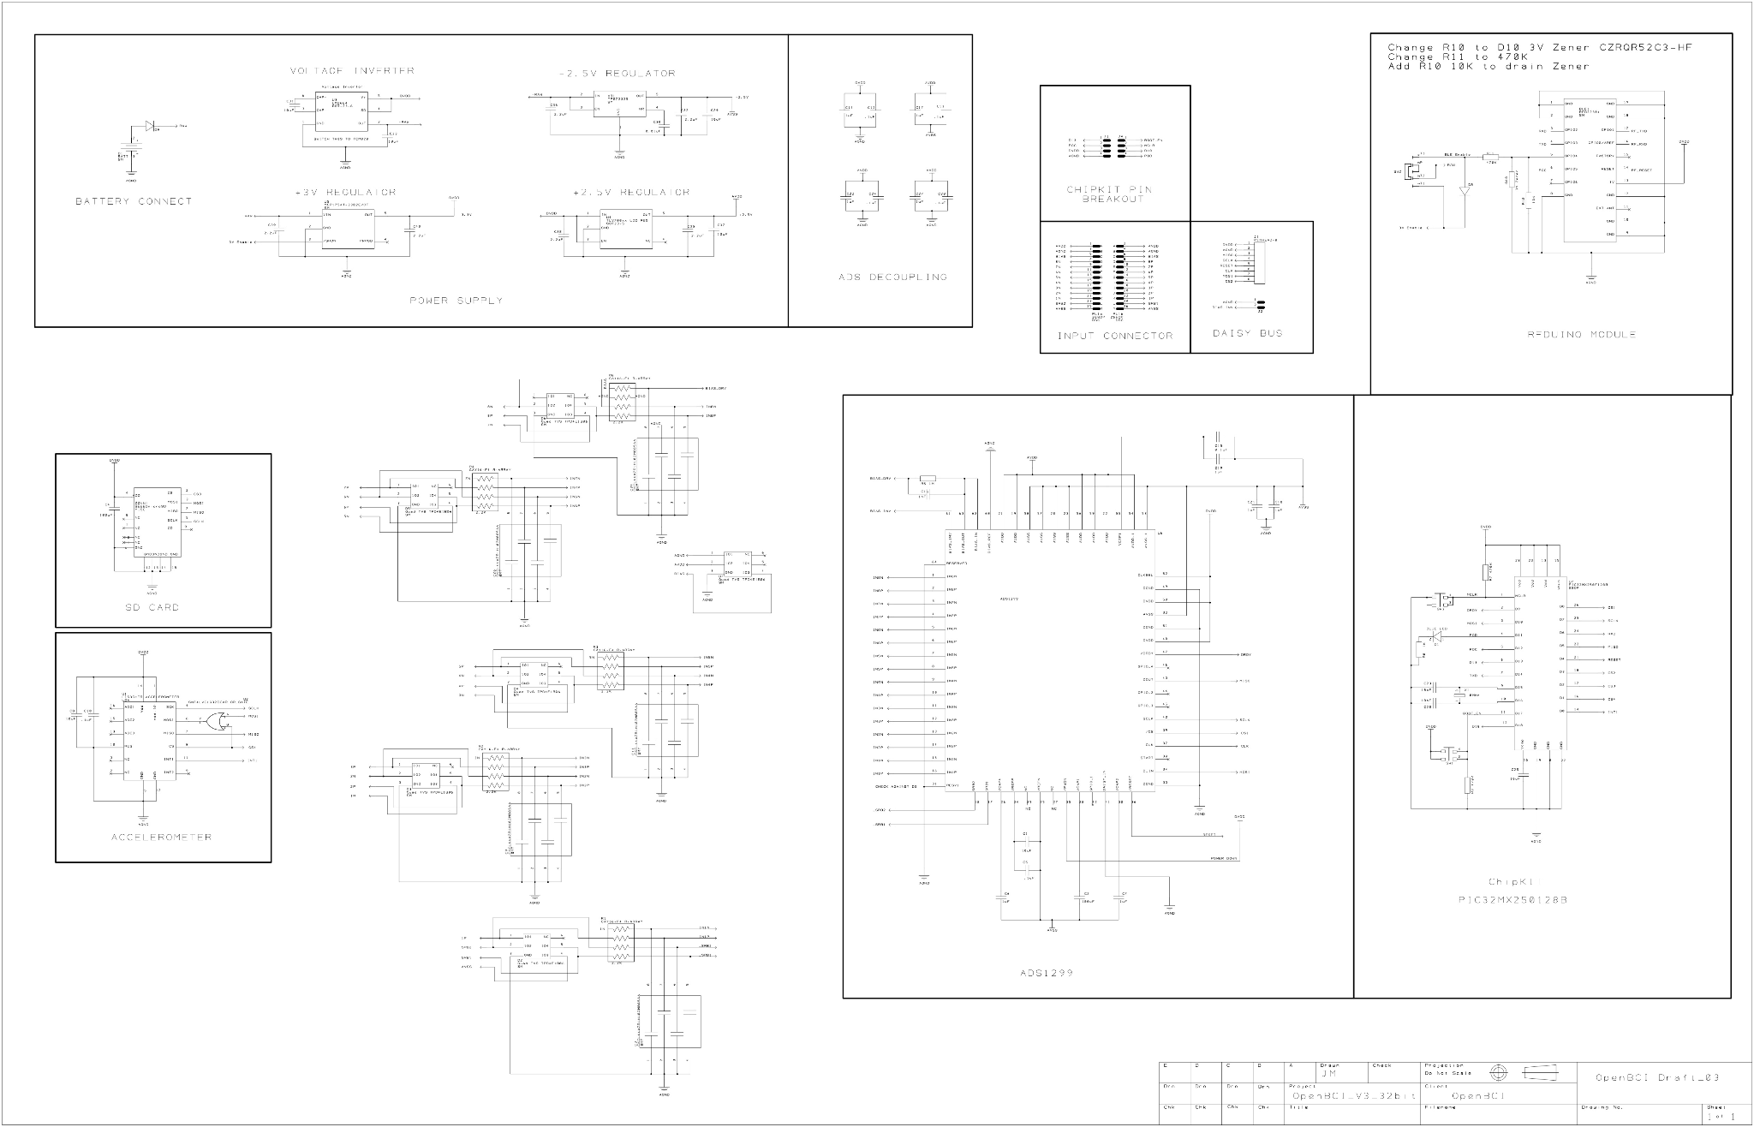

Slide 9
Machine Learning Model
Completed:
In Progress:
Future Plans:
Sample ML Model that can intake EEG Data
Working LSTM Neural Network
Working real-time LSTM Neural Network
Trained and tested on online public databases
Not entirely successful due to lack of pattern in data
Trained and tested on accelerometer data for physical motion
NEEDED: converting old tensorflow version 1 functions to latest version
Trained and tested on data from the EEG headset
Needs to perform with >60% accuracy
TOP PRIORITY: Needs to operate in real-time with minimal latency

Slide 10
Virtual Environment
Completed:
In Progress:
Future Plans:
Panda3D tutorials
Draft Blender® environment
Panda3D script
Interface Blender® models with Panda3D script
Allow user to control object in 4 directions
Implement barriers and roadblocks
Main menu
Ran Panda3D “Hello World” files to test for graphics issues
Created simple Blender® environment to be used in Panda3D model
Panda3D script will be used for controlling the game in real time.
Blender® models can be used in Panda3D using .egg files.
Main menu may have a play button and display high score information
Object should be controlled according to ML classification algorithm
Barriers used to present challenge to a user, have them “think fast”

Slide 11
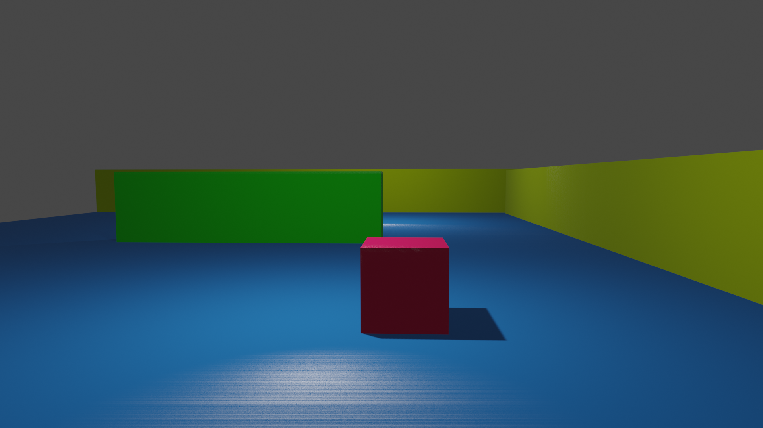
Virtual Environment
Blender®

Slide 12
Spring Semester Goals
Dec. 9
Dec. 22
Dec. 30
Dec. 31
Jan. 31
Feb. 7
Feb. 21
Mar. 7
Stage 1
Stage 2
Stage 3
Stage 4
Stage 5
Stage 6
Stage 7
Stage 8
Order PCB parts
Order/print headset components
Fix bluetooth
Solder PCB
Assemble headset
Collect data from PCB
Process/ Analyze PCB Data
Forward data to ML lead
Complete redesign
Design, train, & test ML algorithm
Build virtual environment
Fabricate redesign
Assemble redesign
Get NN to work live
Design interface between NN & virtual environ.
Test & Debug
Get NN/ virtual environment interface to work live
Set up NN/virtual environment to receive live data from headset
Test and Debug

Slide 13
Questions?

